Slide 1
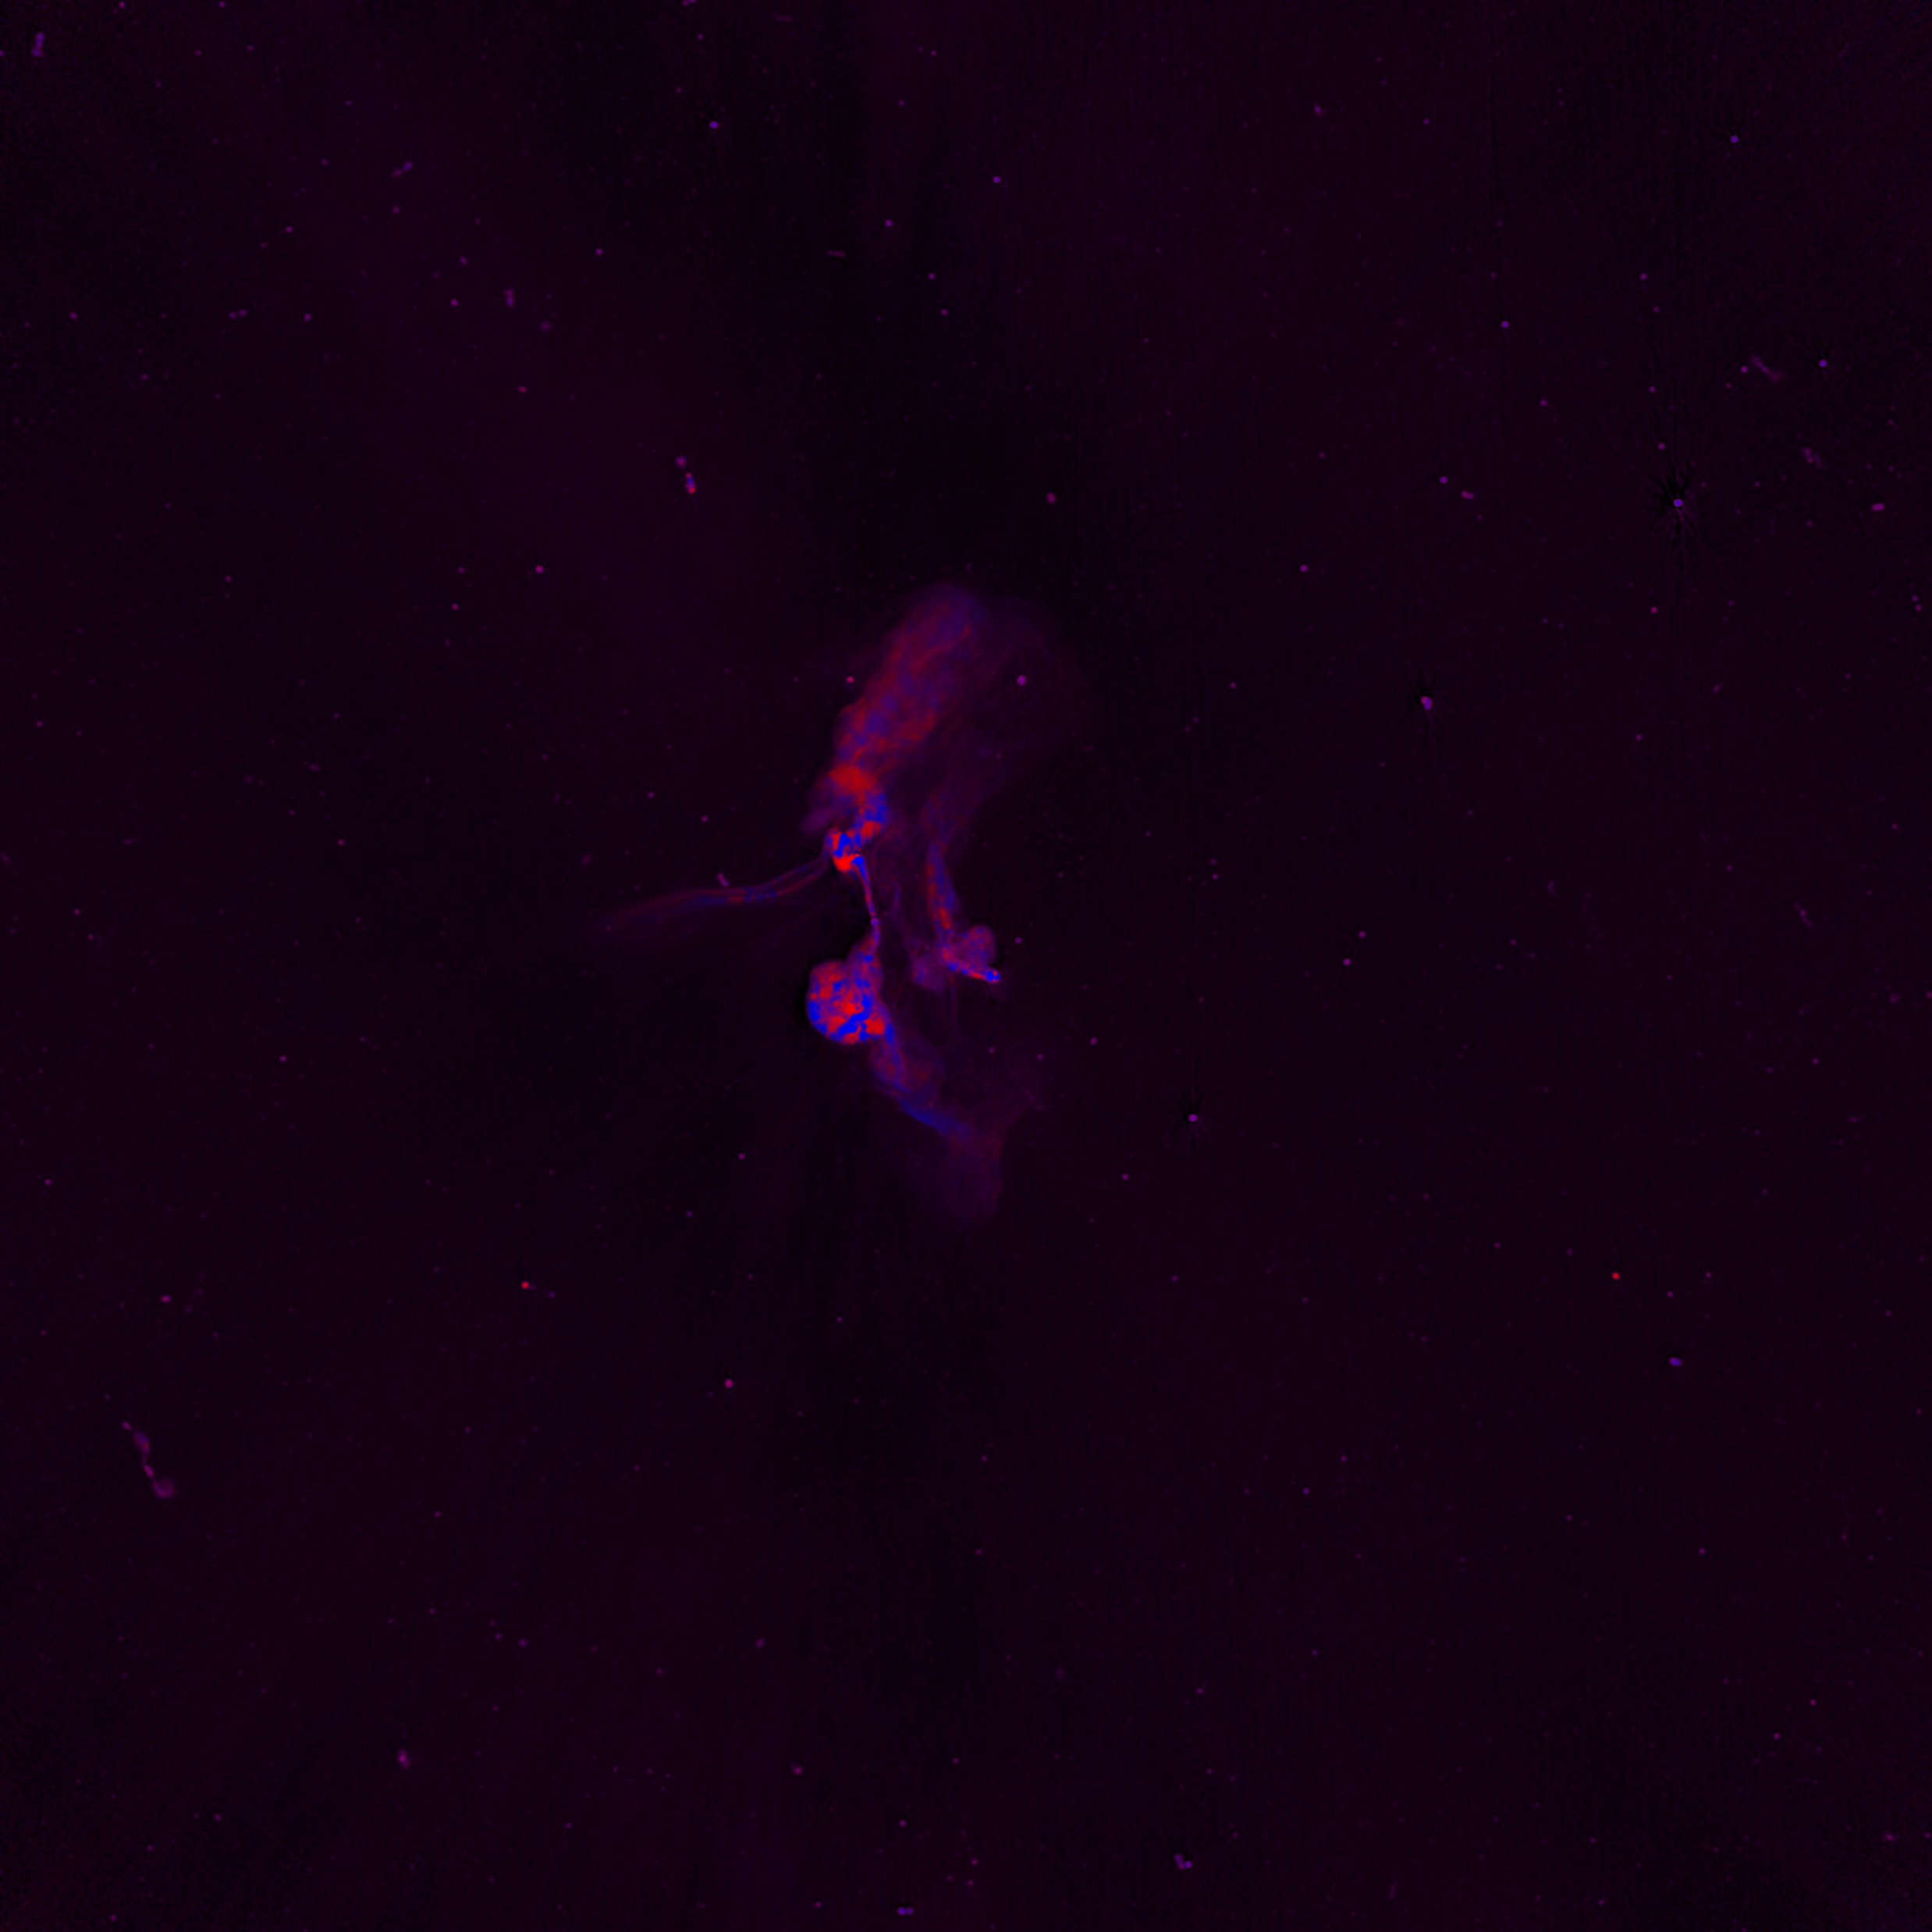
BRP Meerkat Progress Journal February
This Journal contains my whole workflow, notes,…

Slide 2
Step 1: Literature (1)
I read following things:
Fractional polarization as a probe of magnetic fields in the intra-cluster medium
Diffuse Radio Emission from Galaxy Clusters
The MeerKAT Galaxy Cluster Legacy Survey
Magnetic Fields and Faraday Rotation in Clusters of Galaxies
Optical polarization of AGNs, Damien Hutsemékers, (University of Liège, Belgium)
Non-thermal processes in cosmological simulations
Simulations of the Structure of Magnetic Fields in Galaxy Clusters - Forrest Glines https://www.youtube.com/watch?v=lSPh3fEzK6Q
Magnetic Fields in Galaxy Clusters: A Radio Astronomer's Perspective - Chris Riseley https://www.youtube.com/watch?v=K5Wqk3OUE9A&t=232s
Dr. George Heald: Revealing cosmic magnetism with the Square Kilometre Array and its pathfinders https://www.youtube.com/watch?v=2rv4uUDJsIE
The 1.28 GHz MeerKAT DEEP2 Image

Slide 3
Step 1: Literature (2)
Some notes:
Due to the selection, this sub-sample is strongly biased towards clusters with radio halos and relics.
“In Stokes I, we cleaned to a depth of ∼ 80 µJy beam−1, using up to 500,000 components. Stokes Q and U were CLEANed to a depth of ∼ 30 µJy beam−1 with up to 50,000 components. Off-source noise values in images which were not dynamic range limited were ∼3 µJy beam−1.” → does this mean I should ignore sources below this treshhold?
“We used the same 5% frequency bins and the total bandwidth used by the Stokes I imaging, which allows the recovery of RMs up to ± 100 rad m−2 at full sensitivity, with decreasing sensitivity beyond this range.”
There is already a source catalogue available which I can use
Full literature study notes can be found in “Literatuurstudie.docx”

Slide 4
Step 2: Investigate Erik’s method and the problems he faced with VLA (1)
I downloaded Erik’s Git and read his paper.
I discovered that he had to do a lot of calibrating himself which I shouldn’t have to deal with myself → already done by Meerkat team
Erik had data with far lower SNR than Meerkat → should be able to find more sources

Slide 5
Step 3: Downloading and inspecting data (1)
I quickly saw that the 15arcsec version has lower angular resolution → probably a convoluted version of the Farcsec version
Many sources >500 are visible in the I channel
Less sources ~30 are visible on the Q channel, not bad!
There are negative values in the I channel, around artifacts

Slide 6
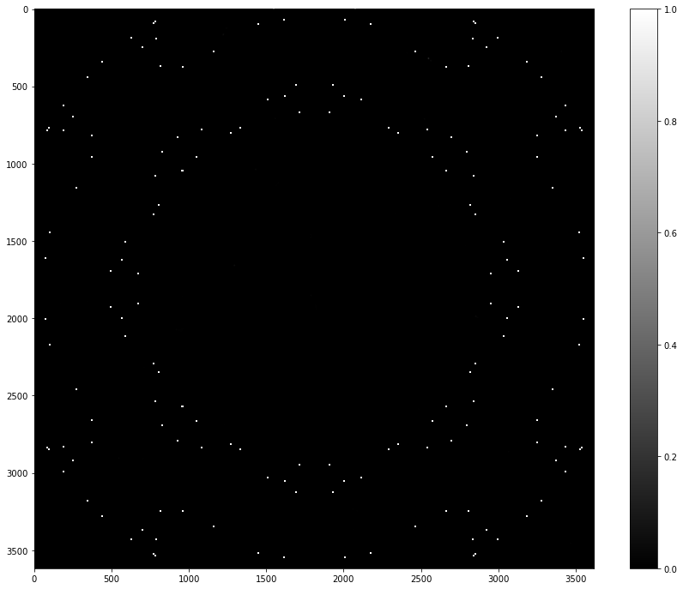
Step 3: Downloading and inspecting data (2)
On the I and Q cubes, a perfect ring is present of NaN pixels, spanning the whole image.
This is not normal. This is visible on more than one image and the circle changes radius depending on the frequency
“To account for the unreliability of primary beam corrections far from the pointing centre, pixels are blanked as for the 5pln cubes discussed above.”
Should we only look at sources within this circle then?
“Derived brightnesses, and especially
spectral indices, are therefore not reliable beyond a radius of 36′.”
I datacube averaged over all frequencies, all rings can be seen:

Slide 7
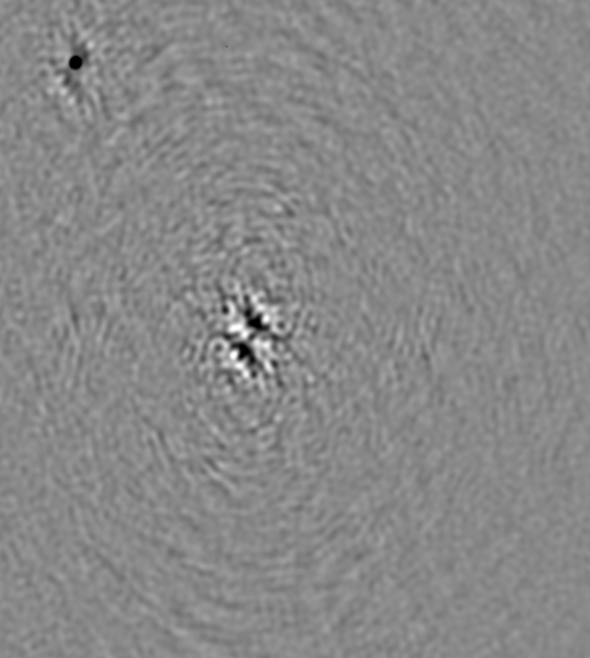
Step 3: Downloading and inspecting data (3)
On the Q channel, some sources are darker than background while others are lighter than the background. This is completely normal!
The artifacts around bright sources become dominant in the Q channel. On the image below, upper left is normal source, middle is artifact.\
“Fields with very strong sources (I > few 100s mJy beam−1) are typically limited by residual artefacts from the brighter sources.”

Slide 8
Step 3: Downloading and inspecting data (4)
A match was searched between the available Meerkat and Eriks VLA polarization data
Three objects were found to overlap:
Abell_85 = G115.16-72.09 = MATCH has 18 Eriksources
Abell_209 = G159.85-73.47 = MATCH has 5 Eriksources, only I,U,V, Q is missing
Abell 133 = G149.55-84.16 = MATCH has 1 Eriksource
The available Full polarization objects, their designations and matches with Erik are put in Available_PolClusters.txt

Slide 9
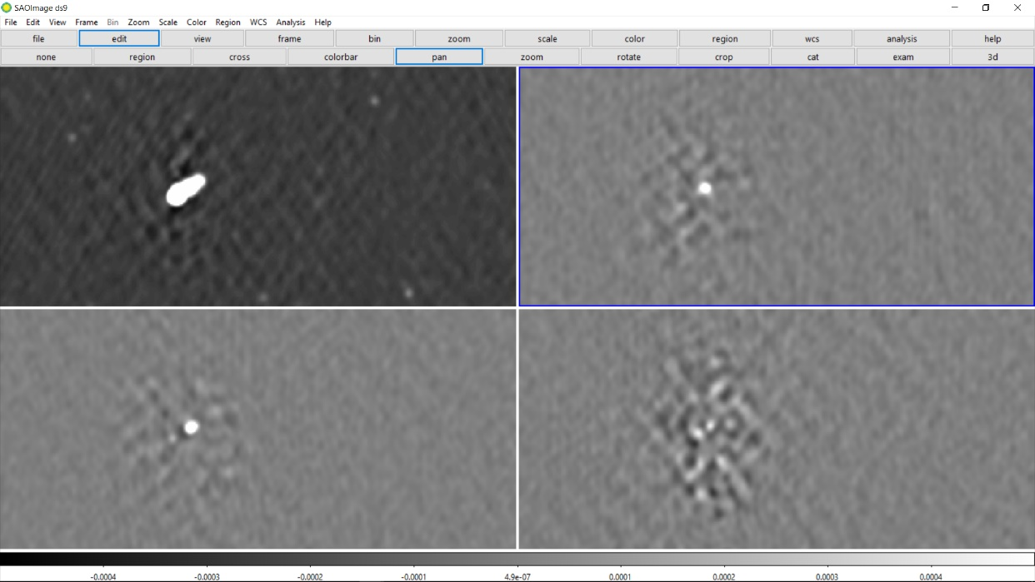
Step 3: Downloading and inspecting data (5)
We look at Abell 85 in I, Q, V and U:
We see that there are about 20 sources of polarization findable in the Q-channel.
If we take a look at one such source, we see that there is also quite some polarization visible in the U channel and some artifacts in V, but no source in V as expected. This is at the longest wavelength. All polarization channels are scaled the same from -0.0005 to 0.0005 Jy/beam. I channel is scaled differently and logarithmically.
I
Q
We also see sources fluctuate quite strongly in both Q and U as we scroll through frequencies → PROMISING!
U
V

Slide 10
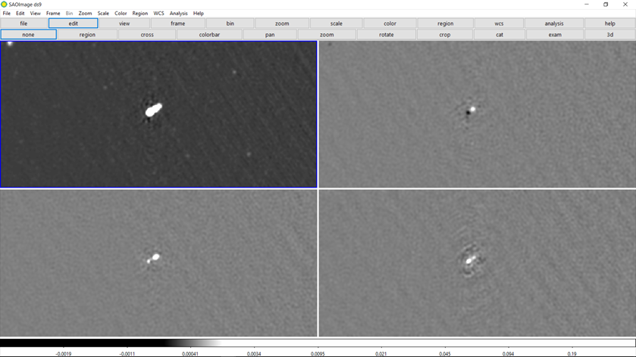
Step 3: Downloading and inspecting data (6)
However, as we decrease the wavelength, a source becomes visible in V also. At image 8-9, we get a negative source in V, at 10 none and at 11-12 a positive source. How is this possible? Below an image with all frames at the 12th shortest wavelength:
I
Q
U
V
This is very strange. Moreover, the amount of circular polarization is in the same order as the linear polarization channels. I find this suspicious, as AGNs generally are NOT circularly polarized. It is checked if this is the same for other sources.

Slide 11
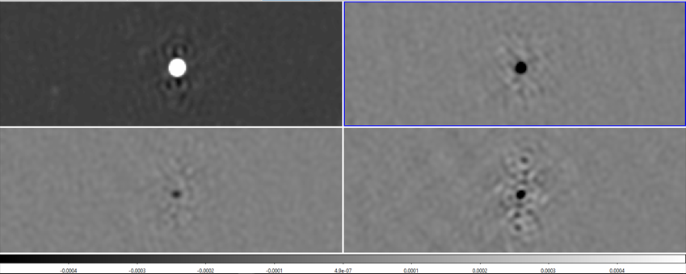
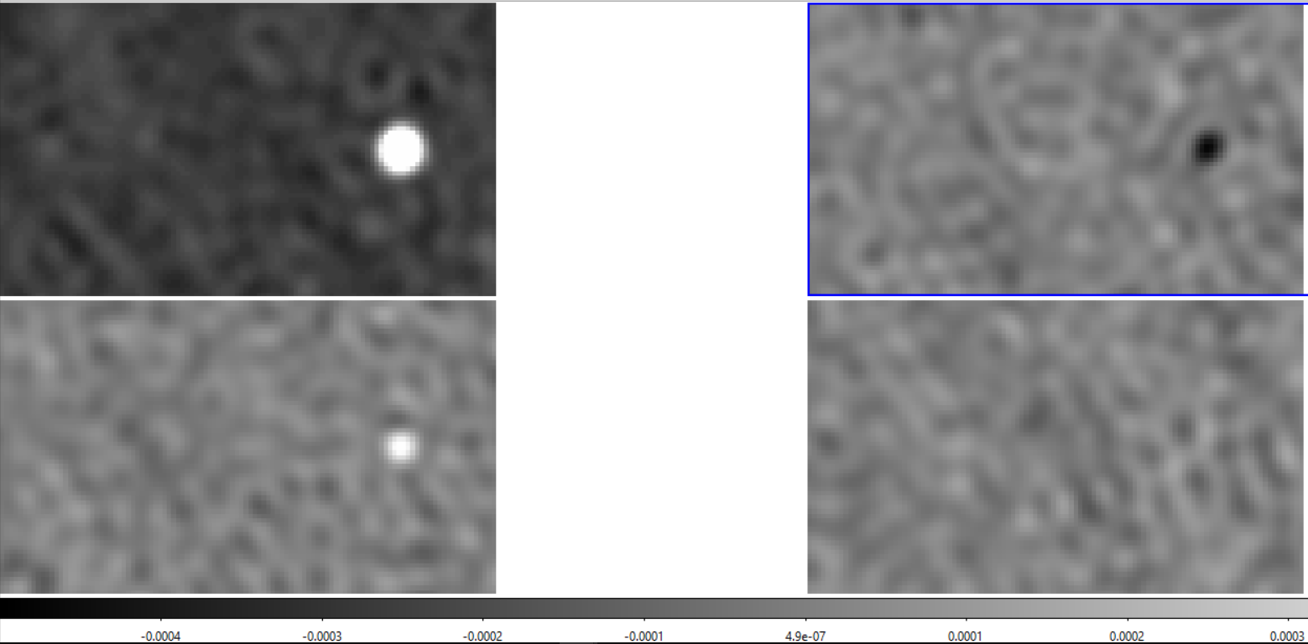
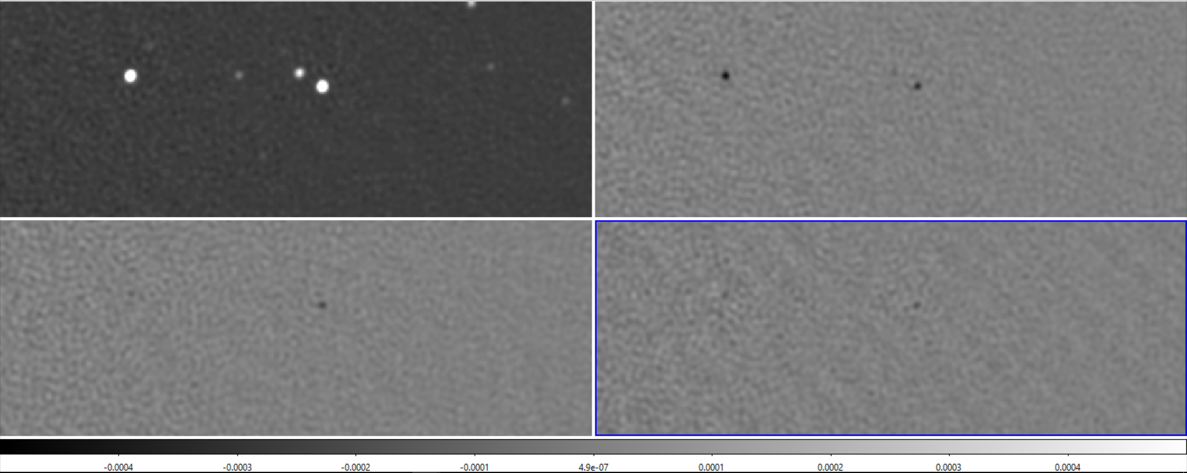
Step 3: Downloading and inspecting data (7)
Also leakage into V channel for other sources?
This other bright source has the same thing going on. But what about dimmer sources?
I
Q
U
V
The dimmer point sources have no circular component, it looks as if circular polarization only is visible when intensity is very large at certain beams → I suspect leakage. Linear polarization could be result of leakage instead of sources themselves.
2 dimmer sources, same IQUV positions in frame:
Erik also a bit concerned but Reinout says:
Op zich niet heel vreemd dat de Stokes V nog best veel signaal laat zien (VLA heeft daar ook wel last van, afhankelijk waar je in het FoV zit). Leakage zal gelukkig geen “oscillerende” Q en U veroorzaken.

Slide 12
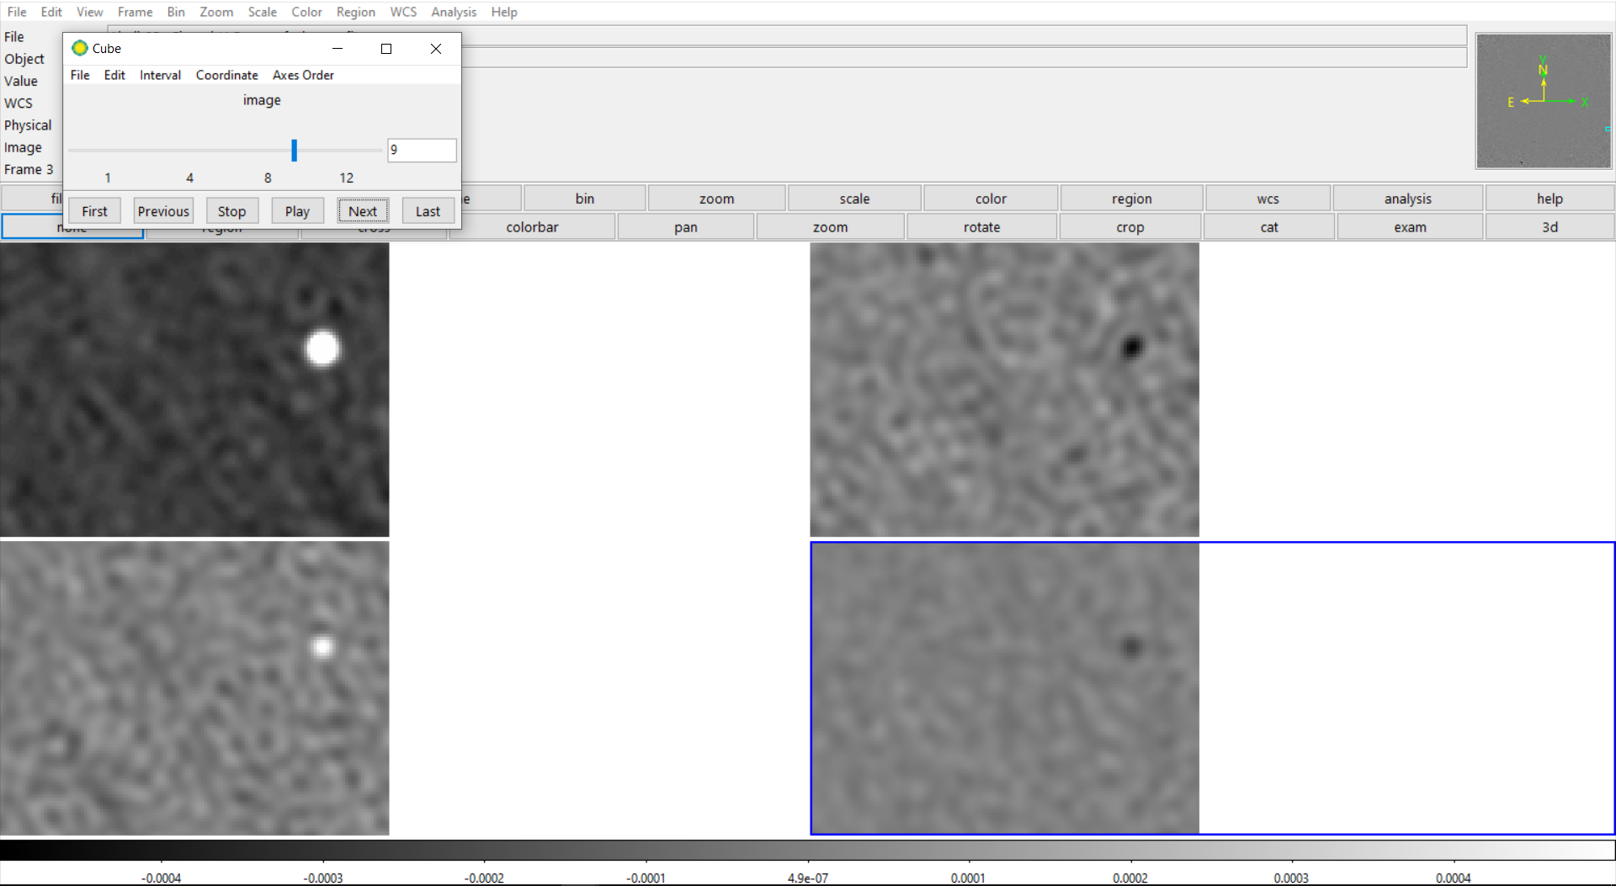
Step 3: Downloading and inspecting data (8)
About dimmer sources and Q leakage:
Note: at wavelength image 9, there seems to be a signal in V for both dimmer sources, all other wavelengths show nothing.
These same dim sources generally mostly show polarization at short wavelengths, not at longer ones. I found a dimmer source that remains polarized at all wavelengths though.
Reason?: “Note that polarisation leakage affects the upper half of the band, with the residual polarisation leakage increasing with distance from the field centre within the half-power region of the beam (de Villiers & Cotton, priv. comm.; de Villiers et al. 2021). The instrumental polarisation may reach up to 10% in the upper part of the band, while it is typically less than 2% at the lower frequencies. Users should evaluate how the leakage affects their particular science case.”
So, sources with polarization at shorter wavelengths only could indicate that they are solely due to leakage. However, this could also be a result from depolarization at longer wavelengths → how to discern?

Slide 13
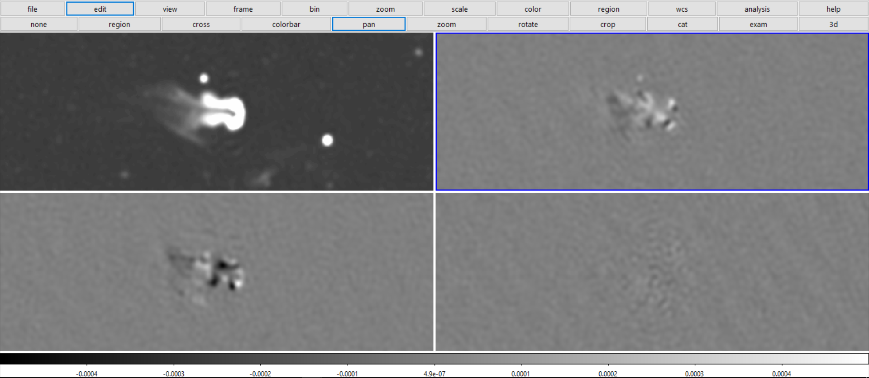
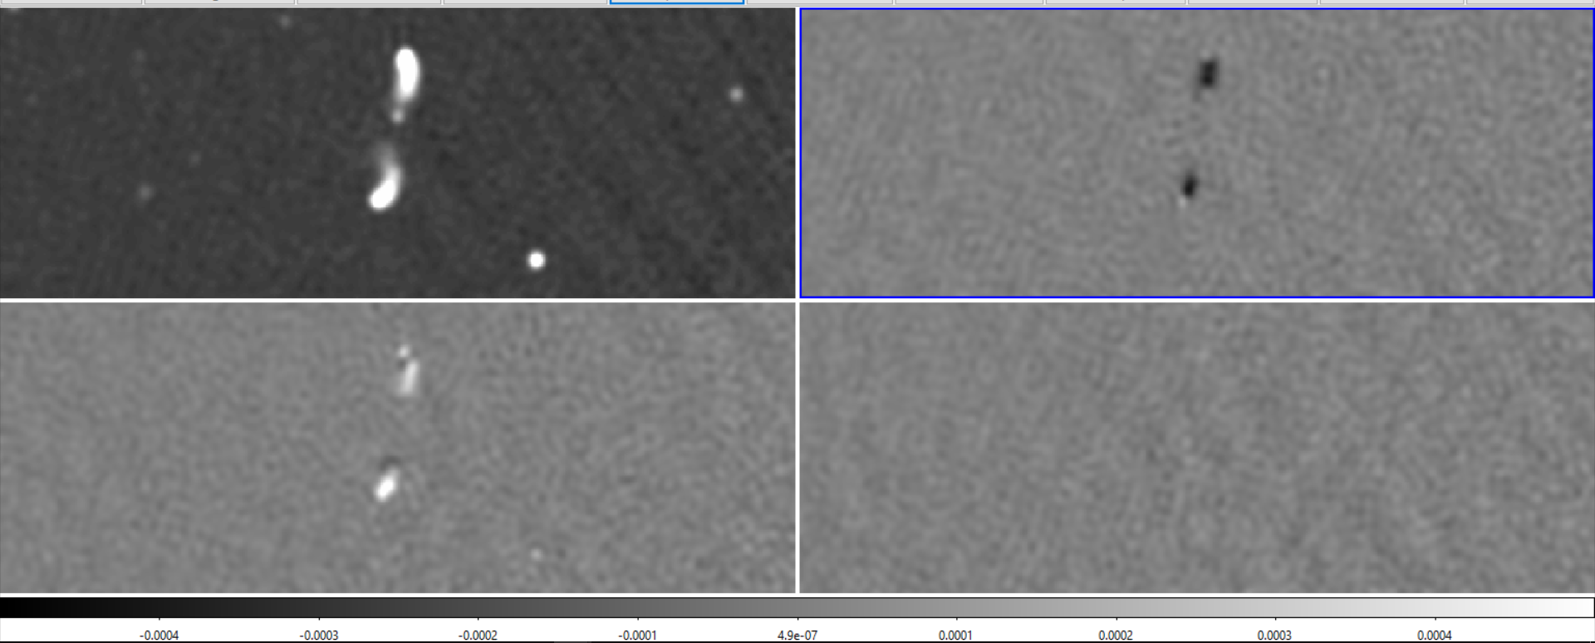
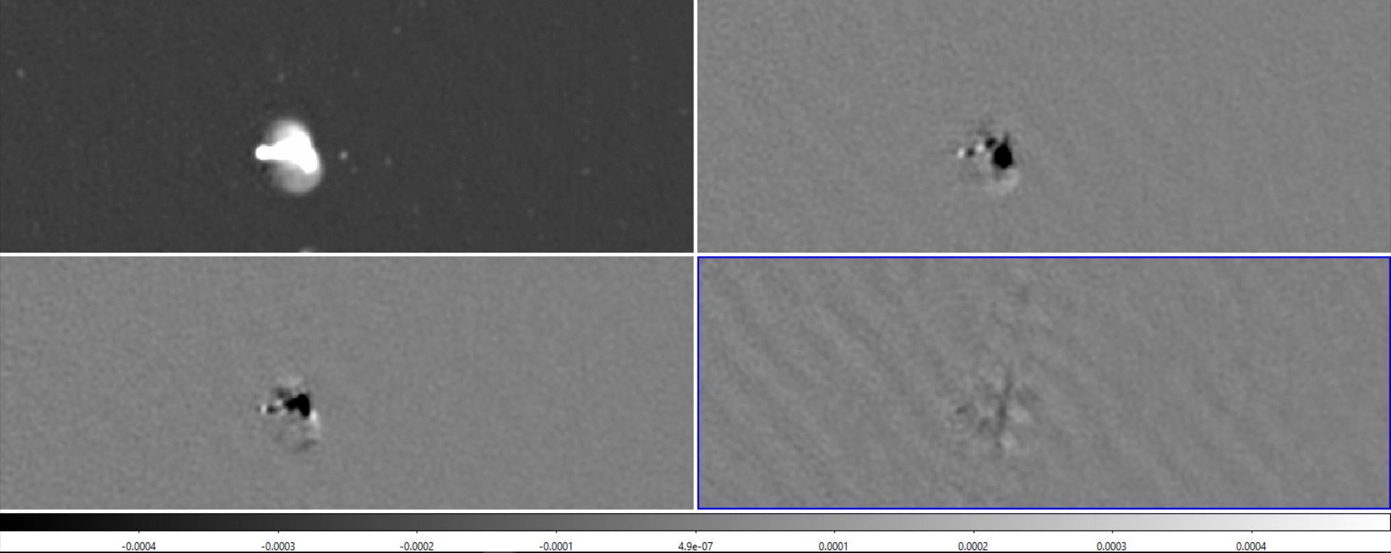
Step 3: Downloading and inspecting data (9)
What about resolved sources of polarization?
For all these diffuse resolved sources, we don’t see the same pattern. We see linear but no circular polarization. For these resolved sources, no circular polarization is seen over the whole spectrum range (apart from some very weak diffuse structures).

Slide 14
Step 3: Downloading and inspecting data (9)
Leakage in V is to be expected according to Meerkat MGCLS paper:
I. Survey Overview and Highlights: Due to the lack of internal polarisation calibration, the Stokes V images are not sufficient to detect weakly circular polarised sources, but can work as an overall check of the quality of the calibration.

